Slide 1
PLAGIARISM AND HOW TO AVOID IT

Slide 2
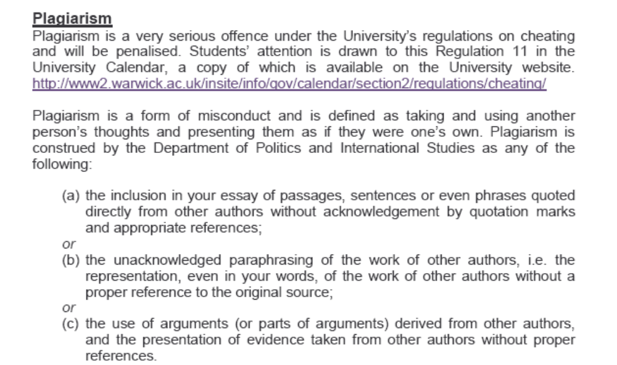
What is plagiarism?

Slide 3
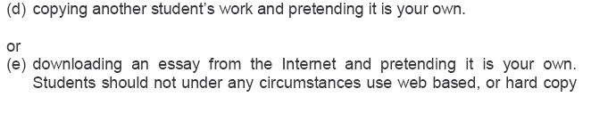
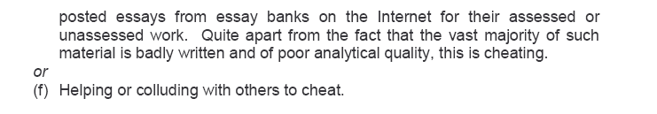
What is plagiarism? (continued)

Slide 4
Why is plagiarism a bad thing?
1. Because it infringes academic ethics and academic norms
2. Because it is a form of theft and a type of fraud
3. Because plagiarists ultimately cheat themselves
4. Because plagiarists cheat their fellow students
5. Because plagiarism reflects incompetence

Slide 5
Procedures
1. You sign a written declaration about plagiarism for every piece of work you submit in PAIS
2, Markers are skilled at picking up plagiarism and we have powerful software available to help us
3. If markers suspect plagiarism, they notify the chair of PAIS and supply evidence
4. The accused is invited to respond to the charge
5. If found guilty, the piece of work in question is graded ZERO

Slide 6

6. Consequences for your overall grade the module in question – mean consequences for your degree
7. Rights of appeal – investigation at the University level
8. Possible disciplinary action by the University

Slide 7
Can you spot plagiarism?
Consider the following extract …

Slide 8
At the beginning, at any rate, the idea of sovereignty was the idea that there is a final and absolute political authority in the political community; and everything that needs to be added to complete the definition is added if this statement is continued in the following words: “and no final and absolute authority exists elsewhere”.
F.H Hinsley Sovereignty (second edition), Cambridge: Cambridge University Press, 1986, pp.25-6

Slide 9
WHICH OF THE FOLLOWING FIVE CASES IS/ARE PLAGIARISM?

Slide 10
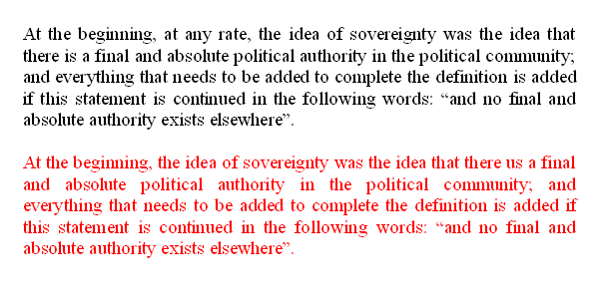
1

Slide 11
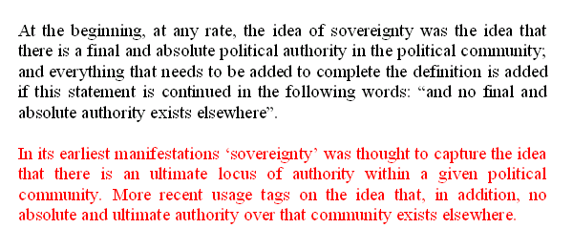
2

Slide 12
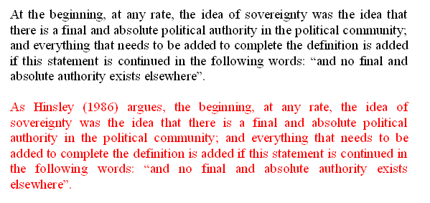
3

Slide 13
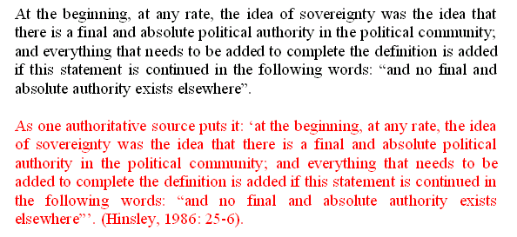
4

Slide 14
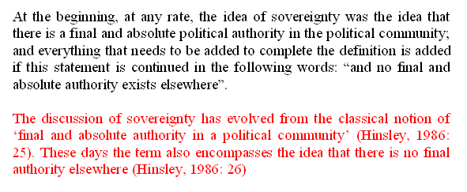
5

Slide 15
So how can plagiarism be avoided?
A prior question …
Why do students plagiarise?

Slide 16
4 commonly cited reasons
1. The pressures of workload
The importance of developing time management skills
2. Pressures to succeed

Slide 17
3. Poor understanding of the nature of plagiarism
confusion
‘cultural’ factors
What goes on in other walks of life
respect for seniority

Slide 18
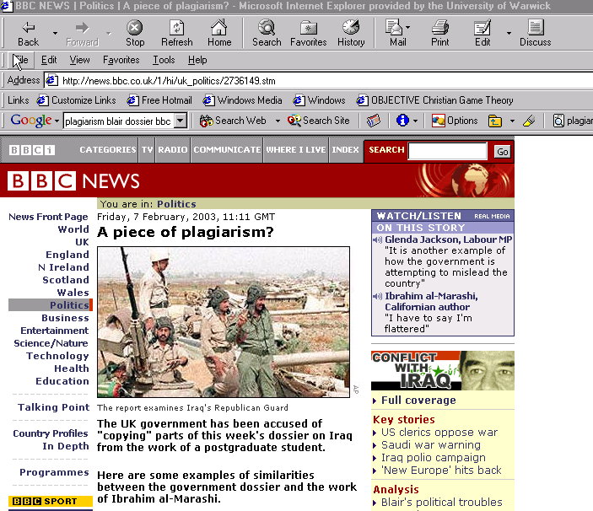
The importance of research skills, note-taking skills and good citation technique

Slide 19
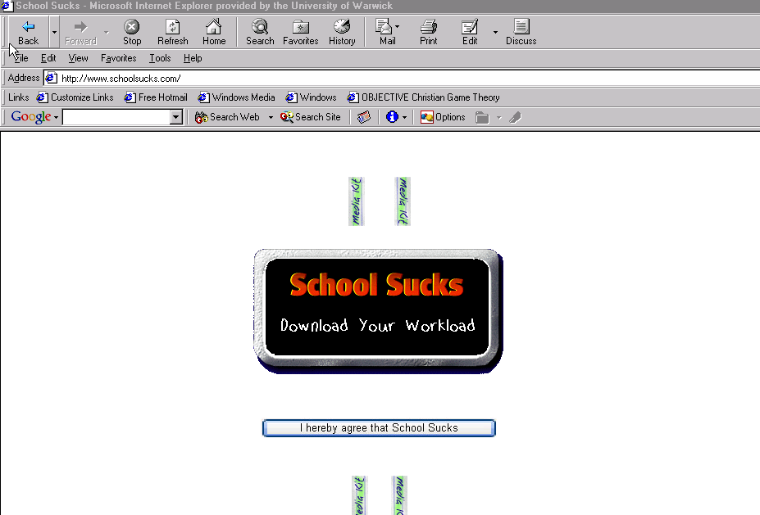
4. Because its easy!

Slide 20
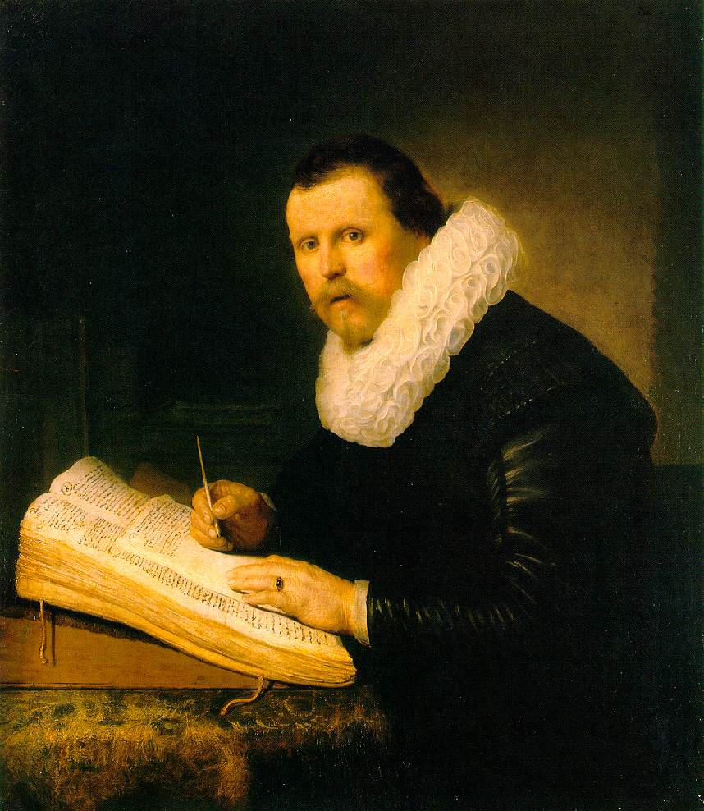
Avoiding Plagiarism Through Good Scholarly Practice….
Making Sure You Are Safe …

Slide 21
When quoting directly
Keep the person’s name near the quote in your notes, and in your paper
Select those direct quotes that make the most impact in your paper -- too many direct quotes may lessen your credibility and interfere with your style
Mention the person’s name either at the beginning of the quote, in the middle, or at the end
Put quotation marks around the text that you are quoting
Indicate added phrases in brackets ([ ]) and omitted text with ellipses (. . .)
Ensure you note exact page numbers in the reference
Source: http://owl.english.purdue.edu/handouts/research/r_plagiar.html

Slide 22
When quoting indirectly
Keep the person’s name near the text in your notes, and in your paper
Rewrite the key ideas using different words and sentence structures than the original text
Mention the person’s name either at the beginning of the information, or in the middle, or at that end
Double check to make sure that your words and sentence structures are different than the original text
Ensure you note exact page numbers in the reference
Source: http://owl.english.purdue.edu/handouts/research/r_plagiar.html

Slide 23
When paraphrasing and summarizing
Action during the writing process
First, write your paraphrase and summary without looking at the original text, so you rely only on your memory.
Next, check your version with the original for content, accuracy, and mistakenly borrowed phrases
Appearance on the finished product
Begin your summary with a statement giving credit to the source: According to Jonathan Kozol, ...
Put any unique words or phrases that you cannot change, or do not want to change, in quotation marks: ... "savage inequalities" exist throughout our educational system (Kozol 1992: 1).
Ensure you note exact page numbers in the reference
Source: http://owl.english.purdue.edu/handouts/research/r_plagiar.html

Slide 24
When researching and note-taking
Action during the writing process
Mark everything that is someone else’s words with a big Q (for quote) or with big quotation marks
Indicate in your notes which ideas are taken from sources (S) and which are your own insights (ME)
Record all of the relevant documentation information in your notes
Ensure you note exact page numbers in the reference
Source: http://owl.english.purdue.edu/handouts/research/r_plagiar.html

Slide 25
A few tips: Good Scholarly Practice
Avoid copying when you take notes; use your own words/ideas
When taking notes, make sure you write down the full reference of the source, INCLUDING PAGE NUMBERS
Keep track of citations, full references, page numbers, quotations
Write first drafts without notes
When in doubt CITE!
Take advice

Slide 26
Some Useful Links about Plagiarism
http://owl.english.purdue.edu/handouts/research/r_plagiar.html
http://www.virtualsalt.com/antiplag.htm
http://www.psa.ac.uk/psanews/0403/plagiarism.htm
http://www.hamilton.edu/academics/resource/wc/usingsources.html?CFID=1415438&CFTOKEN=46586906

